Slide 1
MOVIE RECOMMENDATION SYSTEM USING DJANGO
MINI PROJECT PRESENTATION
SUBMTTED BY:T.LAVANYA
ROLL NUMBER:23AK1A0455

Slide 2
INTRODUCTION
A Movie Recommendation System using Django is a web application that suggests movies to users based on their interests and preferences. It uses Django to manage movie data and provide personalized recommendations through a user-friendly interface.

Slide 3
PROBLEM STATEMENT
Users often find it difficult to choose movies from a large collection available online. The Movie Recommendation System using Django aims to provide personalized movie suggestions based on user preferences, helping users quickly discover relevant and interesting movies.

Slide 4
OBJECTIVE
To develop a web-based movie recommendation application using Django.
To recommend movies based on user preferences and interests.
To provide a simple and user-friendly interface for users.
To help users discover relevant movies quickly and easily.
To improve the overall movie selection experience.

Slide 5
TECHNOLOGIES USED
Python – Core programming language.
Django – Web framework for backend development.
HTML – Structure of web pages.
CSS – Styling and design of the user interface.
JavaScript – Interactive frontend functionality.
sqlite3

Slide 6
SYSTEM ARCHITECTURE
User → Frontend → Django Server → Recommendation Engine → Database → Recommended Movies → User.

Slide 7
PROJECT MODULES
User Management Module:- User registration, login, and profile management.
Movie Database Module:- Stores movie details such as title, genre, rating, and description.
Search Module:- Allows users to search movies by name or genre.
Recommendation Module:- Generates personalized movie recommendations based on user preferences.

Slide 8
IMPLEMENTATION
A Movie Recommendation System using Django is developed to provide personalized movie suggestions based on user preferences and movie characteristics. The system stores movie details and user ratings, then applies recommendation algorithms to identify similar and relevant movies. Django's MVT architecture efficiently manages data processing, user interactions, and result presentation, delivering an intelligent and user-friendly movie discovery platform.

Slide 9
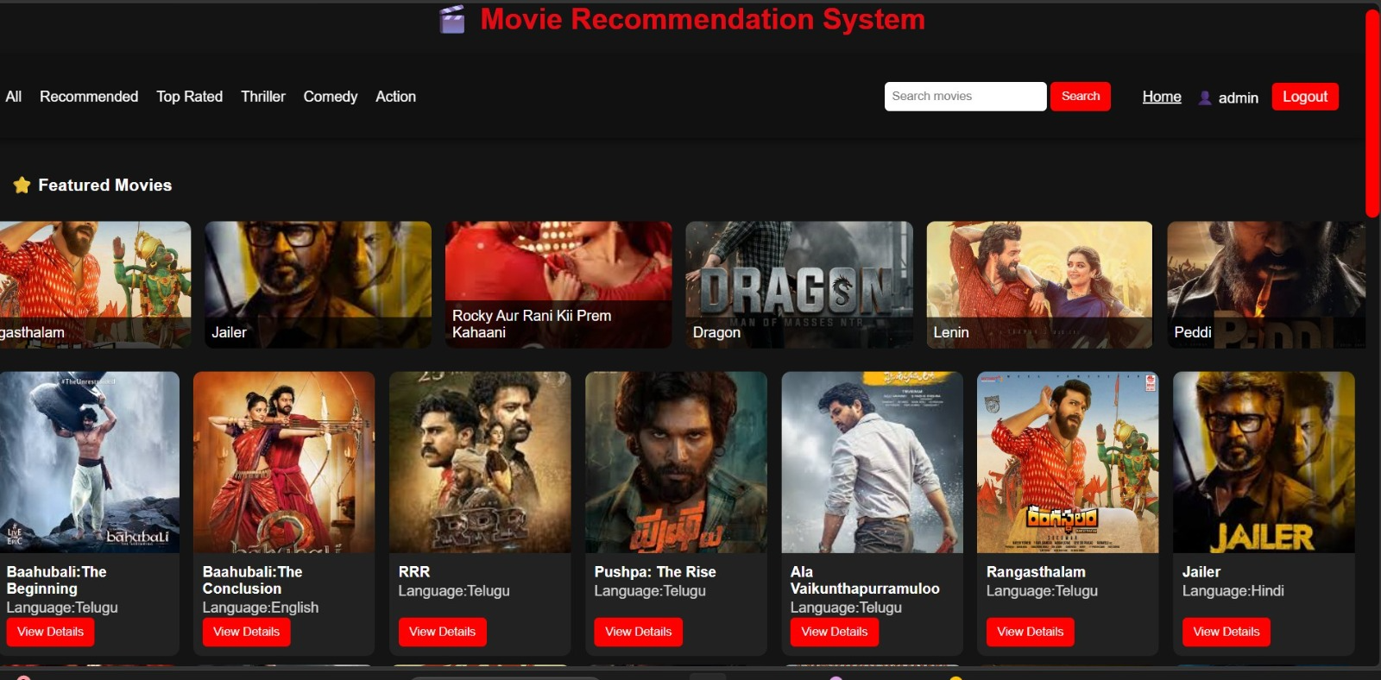
RESULTS AND OUTPUT

Slide 10
CONCLUSION
The Movie Recommendation System using Django successfully provides personalized movie suggestions based on user preferences. It helps users discover suitable movies quickly, improves the movie selection experience, and demonstrates the effective use of Django for developing intelligent web applications.

